Slide 1
URBANCART
( E - Commerce Website )
Submitted To:
Ms. Meenakshi
Mr. Shiv Mohan
Submitted By:
Team No. 8
Joel Matthew (465)
Karan Kumar Garg (478)
Kartavya Tomar (484)
Kashish (495)
Kshitij Gulati(525)

Slide 2
Table of Contents:
Introduction
Overview
Problem Statement
Tools used
Bonus Feature(optional)
Technical Details
Conclusion
References/Links used

Slide 3
Introduction
URBANCART is a dynamic e-commerce platform designed to elevate your shopping experience by offering a diverse range of products that cater to urban lifestyles.
Whether you're searching for the latest fashion trends, cutting-edge electronics, or essential home goods, URBANCART provides a seamless and intuitive shopping experience.
With a focus on quality, affordability, and convenience, the platform connects you with top brands and unique items, ensuring you find exactly what you need.
Fast shipping, secure payment options, and exceptional customer service are at the heart of URBANCART, making it your go-to destination for all your online shopping needs.

Slide 4
OVERVIEW
URBANCART is a modern e-commerce platform designed to bring a seamless shopping experience to urban dwellers.
Specializing in a wide range of products, from fashion and electronics to home essentials and lifestyle accessories, URBANCART caters to the diverse needs of city life.
The website offers an intuitive and user-friendly interface, making it easy for customers to browse, compare, and purchase products. With secure payment options, fast delivery services, and a dedicated customer support team, URBANCART ensures a reliable and satisfying shopping journey.
Whether you're looking for the latest trends or everyday necessities, URBANCART is your go-to destination for quality products at competitive prices, all from the comfort of your home.

Slide 5
Problem Statement
Inefficient Product Management: Many e-commerce platforms lack a robust backend system to efficiently manage product inventory, including adding, updating, and deleting products through a centralized API.
Security Vulnerabilities: There is a critical need for better security measures to protect user data and ensure that only authenticated users can access sensitive information, such as the product database.
Poor User Experience: The absence of a dynamic and responsive frontend interface can lead to a subpar user experience, making it challenging for customers to navigate the site and find products easily.

Slide 6
TOOLS and Languages
Here are all the tools and languages used to build Soporific:
Front-End : HTML, CSS, JavaScript , React js
Back-End : Express js , Node js
Database: MongoDB
Development tool : Web Browser , Vs Code

Slide 7
Features-
1. Multi-Panel Architecture:
Admin Panel: Manage users, products, and overall platform settings.
Seller Panel: Manage product listings, inventory, and sales.
User Panel: Seamless shopping experience with personalized features.
2. Secure Login/Signup functionality:
Passwords encrypted using bcrypt. Data stored securely in MongoDB.
3. Product Filters:
Advanced filtering options for users to find products by:On Sale, New Arrivals, Brands, Sizes, Styles, etc.
4. Cart Management:
Users can add, view, and maintain their cart for a smooth shopping experience.

Slide 8
Technical Details
Backend Functionality
API Development:
Custom API: Developed using Node.js and Express.js.
Endpoints:
Product Management: APIs for adding, updating, deleting, and retrieving products.
User Management: APIs for user signup, login, and authentication.
Data Storage:
Database: DB for storing product and user data (could be replaced with a more robust database like MongoDB or SQL in a production environment).
CRUD Operations: Handling of product data through API endpoints.
Authentication:
Security: Implementation of authentication mechanisms using user’s email and password.
User Management: Secure handling of user credentials and session management.

Slide 9
Technical Details
2. Frontend Functionality
React.js: Used to build a dynamic and responsive user interface.
Toastify: For user notifications and alerts (e.g., success or error messages).
Components Admin Panel: Interface for managing sellers and products.
User Panel: Dashboard for users to browse and purchase products.
Seller Panel: Tools for sellers to manage their listings.
Product Display: Components to showcase products fetched from the backend.
Login/Signup Forms: Components for handling authentication processes.

Slide 10
Technical Details
Routing React Router:
Handles navigation between pages such as login, signup, admin dashboard, product listings, etc.
Data Handling Axios:
Used for making HTTP requests to the backend API for data retrieval and submission.
State Management:
use State: For managing component-level state.
use Effect: For handling side effects such as API calls.
Additional Features Responsive Design:
Ensures compatibility with various screen sizes and devices.
Interactive UI:
Provides a seamless user experience for all roles (admin, user, seller).

Slide 11
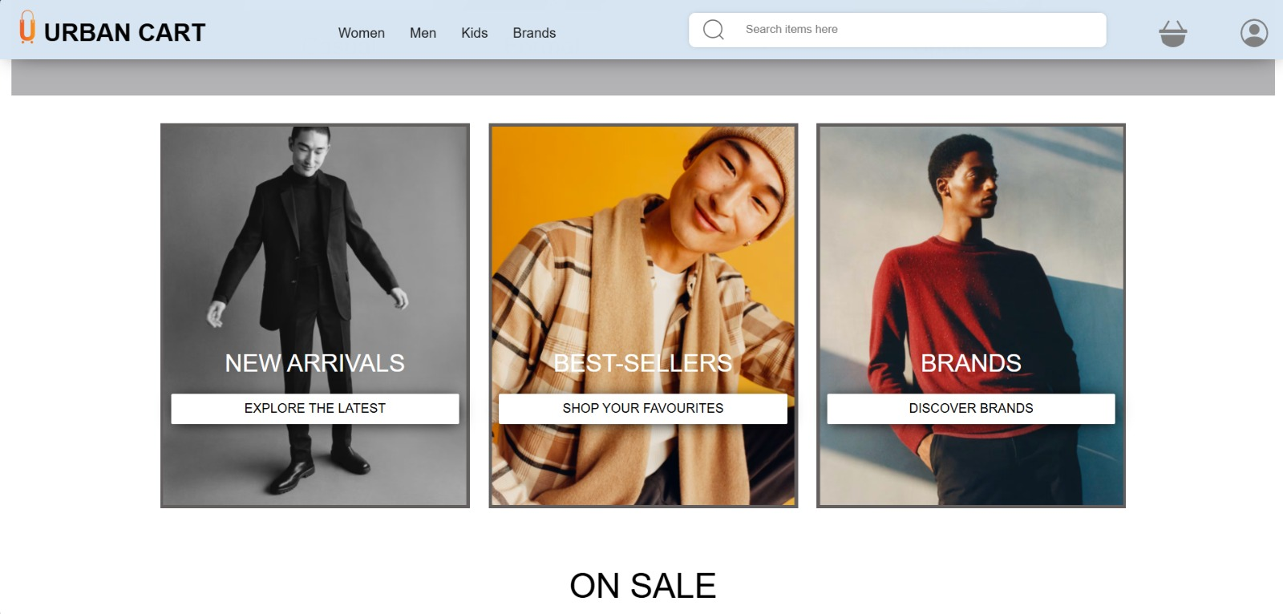
HOME

Slide 12
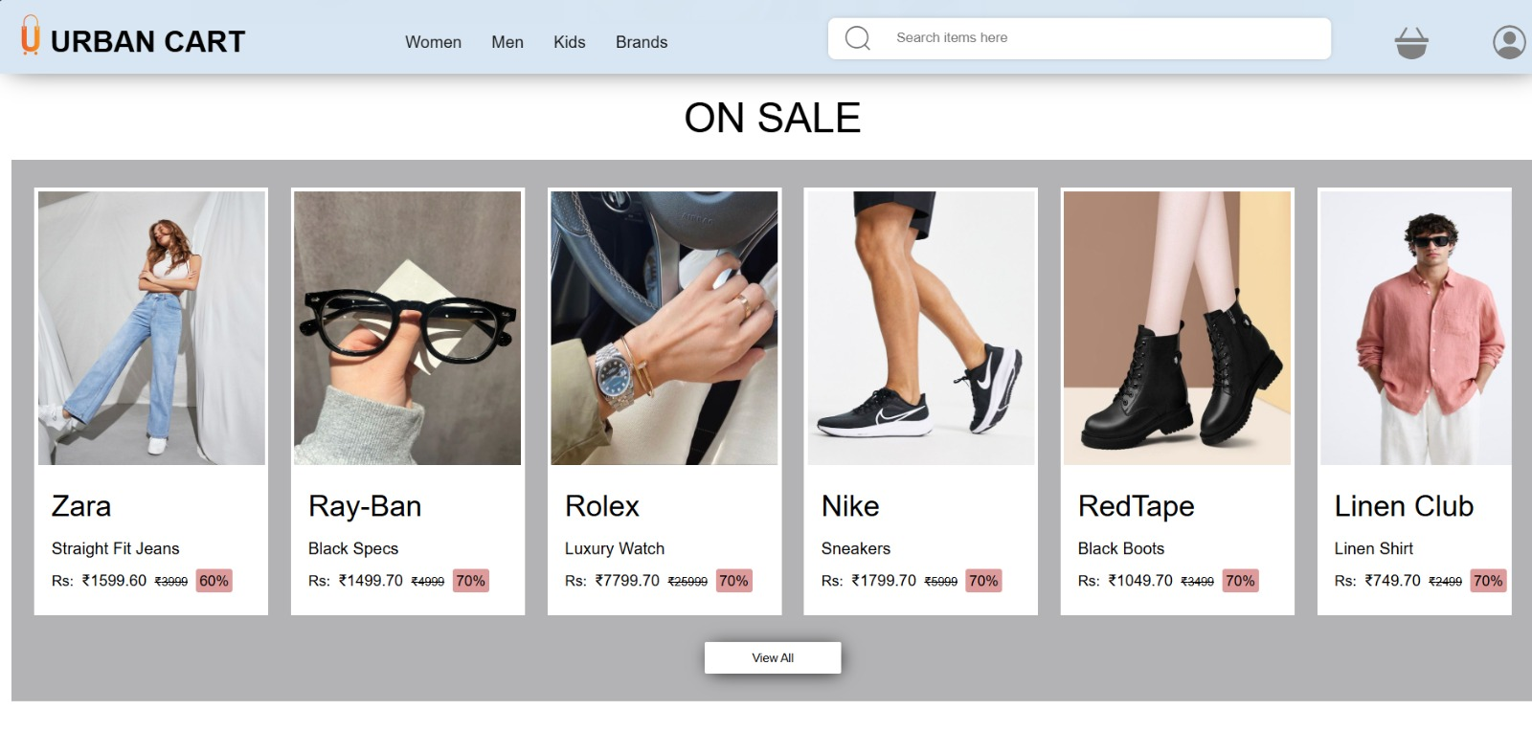
Sales

Slide 13
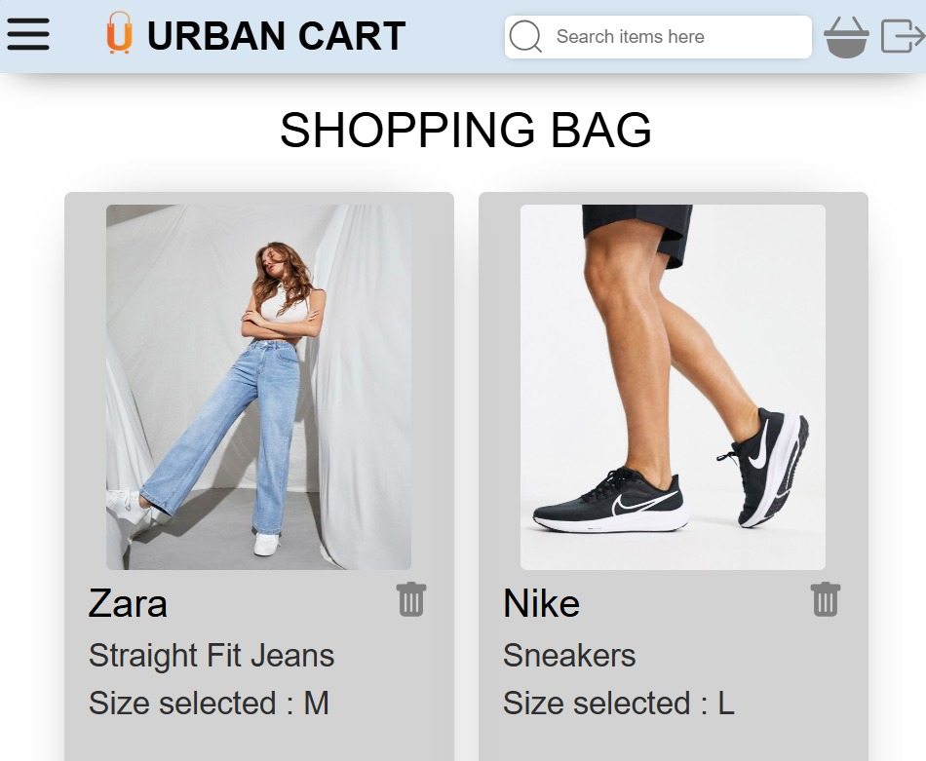
CART

Slide 14
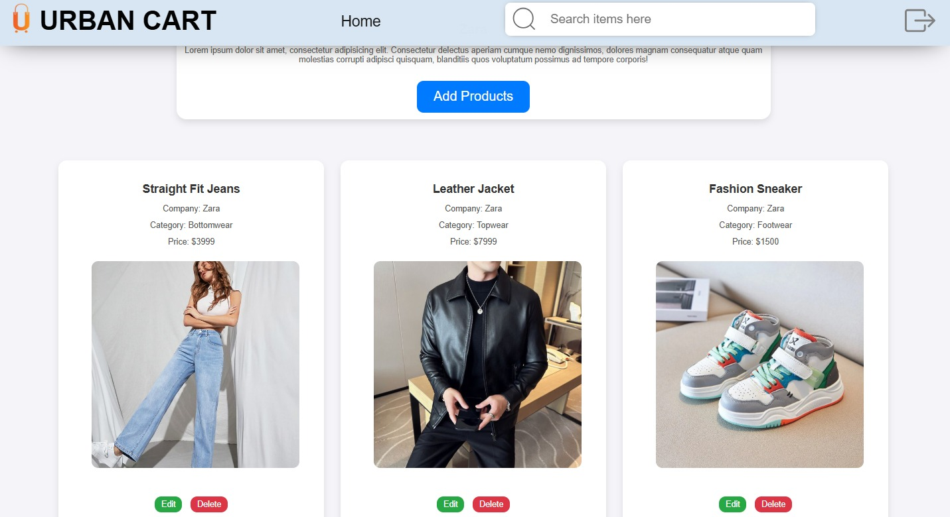
Seller Products

Slide 15
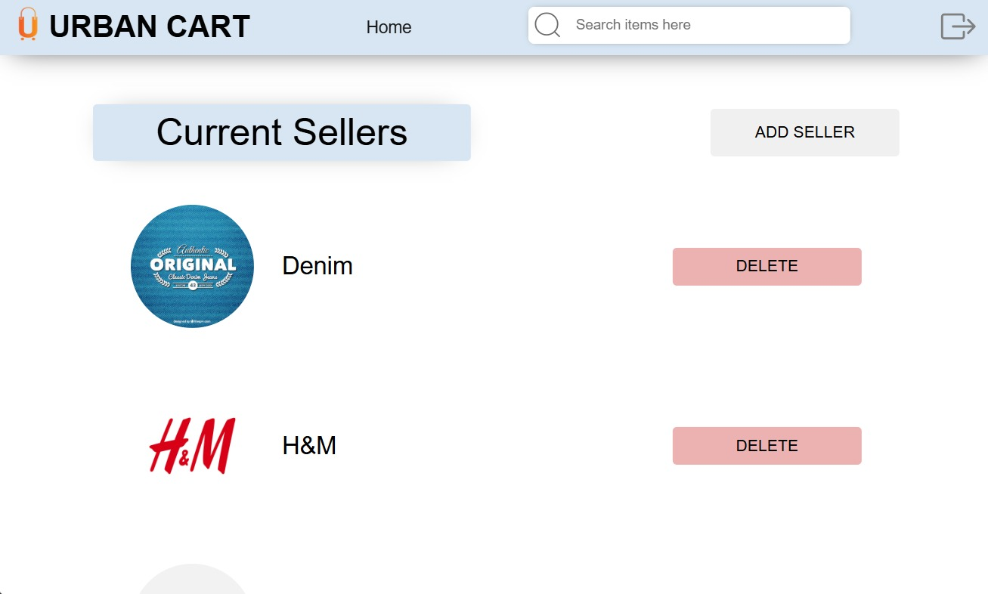
Admin Page

Slide 16
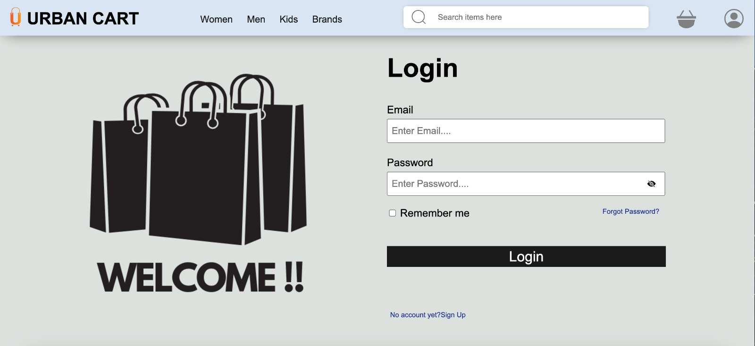
Login Page

Slide 17
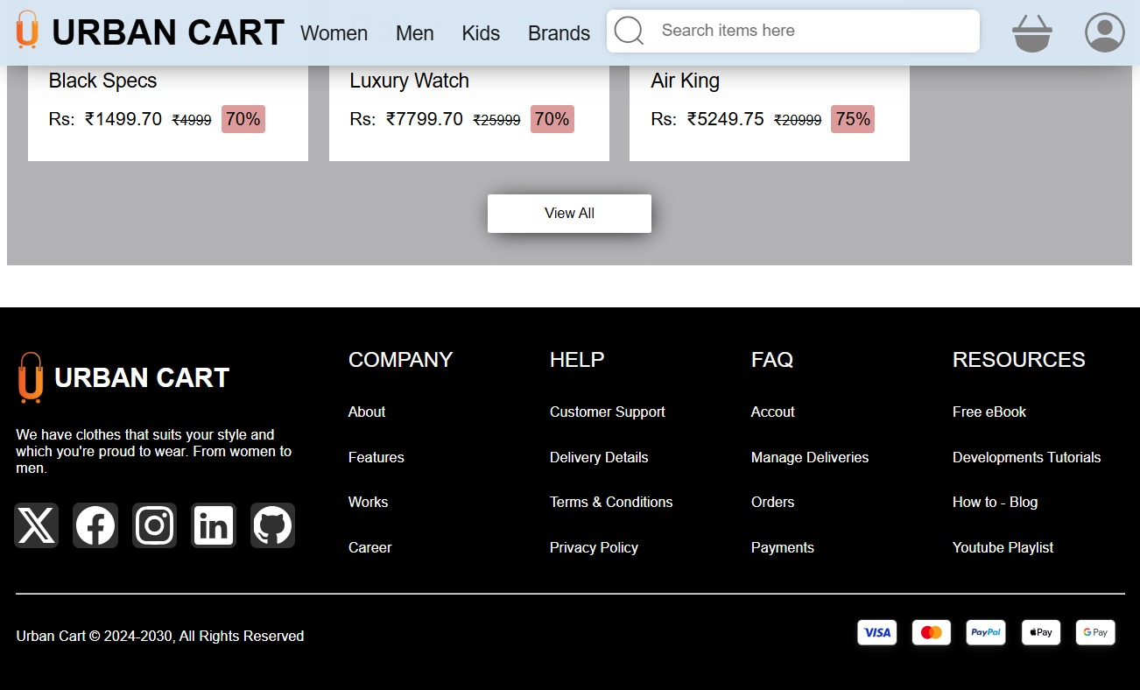
CONTACT US

Slide 18
Conclusion-
The project was a E commerce Web, which involved designing and developing software to make orders, search items on web.
Key features of URBANCART include -:
Browse Menu Add to Cart
Secure Payment Gateway Responsive Design
Special Offers and Discounts Sign Up Feature

Slide 19
References/Links used
W3 Schools - https://www.w3schools.com/
MDN Web Docs - https://developer.mozilla.org/en-US/
Tutorials Point - https://www.tutorialspoint.com/index.html
css-tricks - https://css-tricks.com/
Geeksforgeeks - https://www.geeksforgeeks.org/

Slide 20
THANK YOU

